Slide 1


Simulation and Debug
Dr. Ruba Alkhasawneh

Slide 2
Why Simulation?
Advantages:
Cost-effective: reduce development costs as it eliminates the need for physical hardware prototypes.
Early error detection: provide early bug detection before the design is implemented on the hardware.
High visibility of all signals in the design.
Faster time-to-market: provides early detection of design issues which reduces the overall development time.
Disadvantages:
Hardware testing & performance: e.g. interacting with external peripherals and sensors.
Can take a long time to run – Software-based.

Slide 3
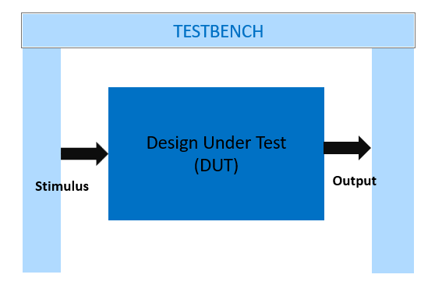
Testbench
A test bench or testing workbench is an environment used to verify the correctness or soundness of a design or model.

Slide 4
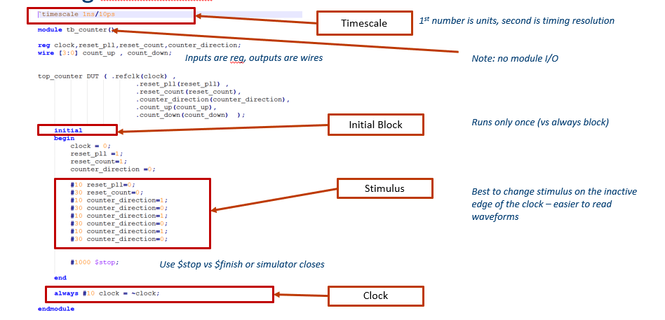
Verilog Testbench
Source: https://fpgacademy.org

Slide 5

Handy Verilog Testbench Constructs
$dumpfile(“testbench_results.vcd”);
Specifies file to dump signals to view later in a waveform viewer
$dumpvars;
Dump all signals to dumpfile
$display("\t\ttime,\tclk,\treset,\tenable,\tcount");
Write text to console once
$monitor("%d,\t%b,\t%b,\t%b,\t%d",$time, clk,reset,enable,count);
Monitor signal activity – write upon events of sensitivity list
Source: https://fpgacademy.org

Slide 6
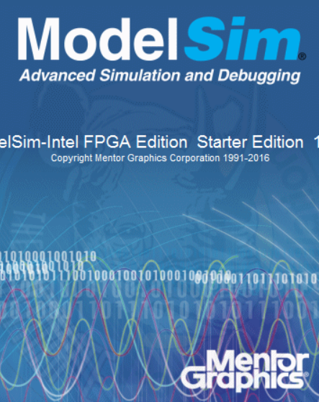
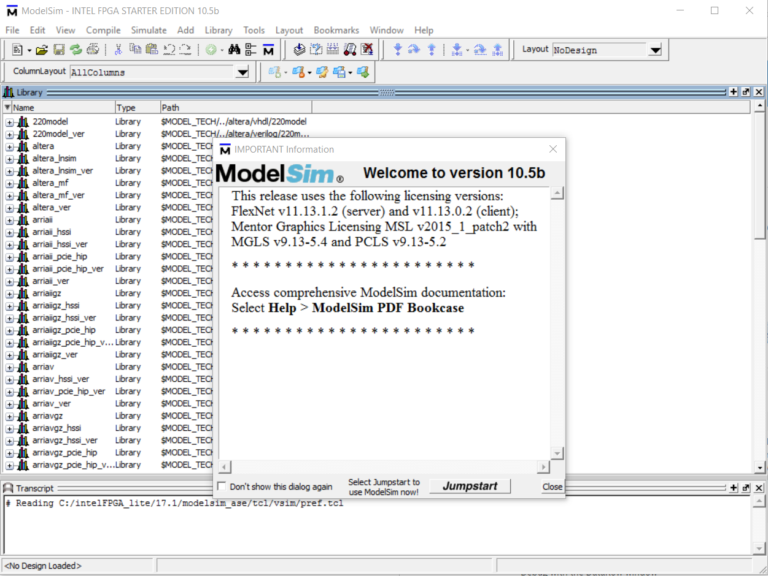
Mentor ModelSim Overview
ModelSim is a multi-language HDL (Verilog/VHDL) simulation environment. It can be used independently or Intel Quartus can create startup scripts and link designs to ModelSim.
Intel Quartus has a license to distribute Modelsim-Altera with Quartus.

Slide 7
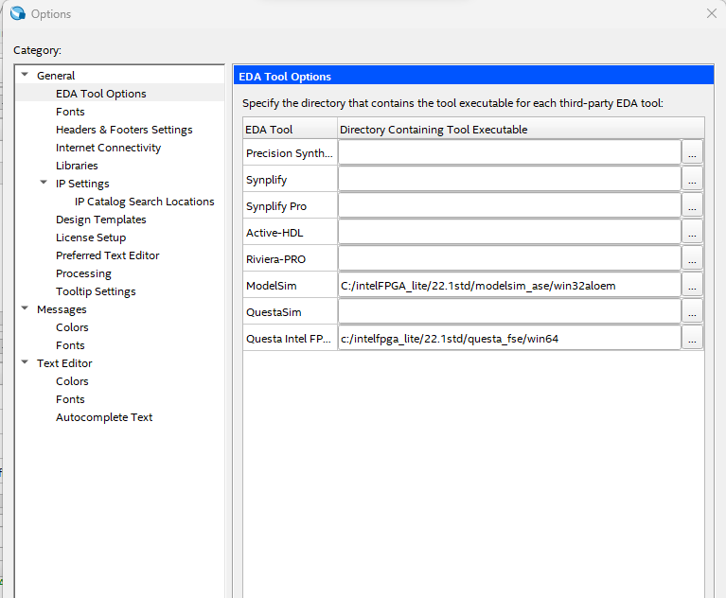
Modelsim setup - 1
Go to Tools → Options → EDA Tool Options. In ModelSim-Altera, enter the executable pathway.
This path might be different for your own installation!

Slide 8
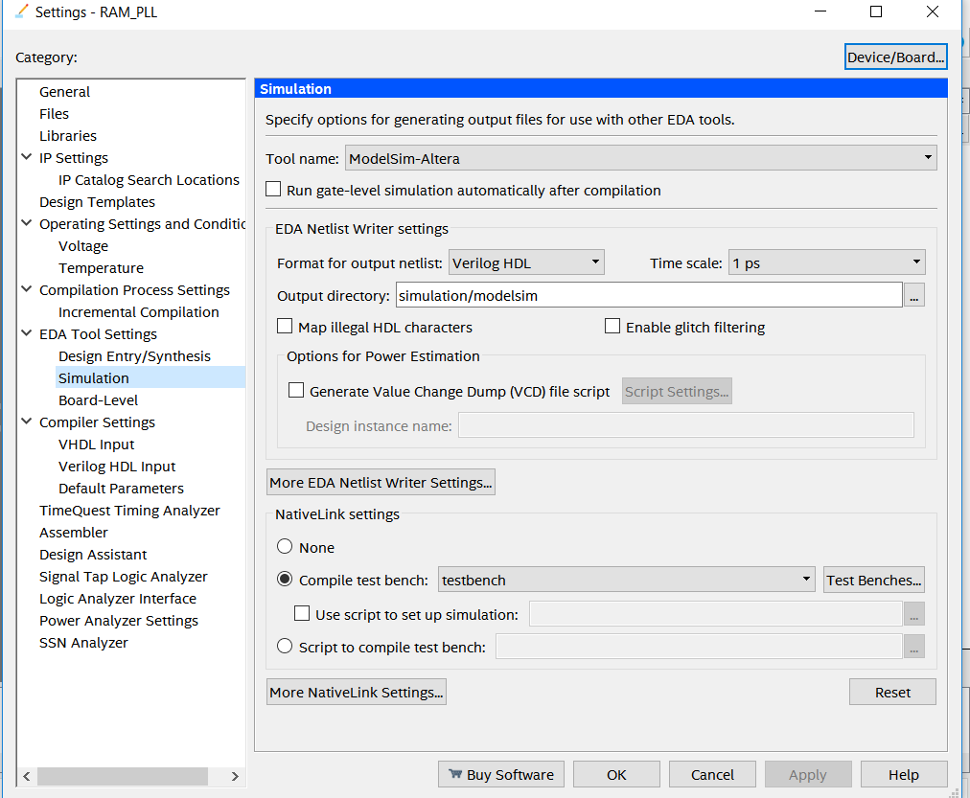
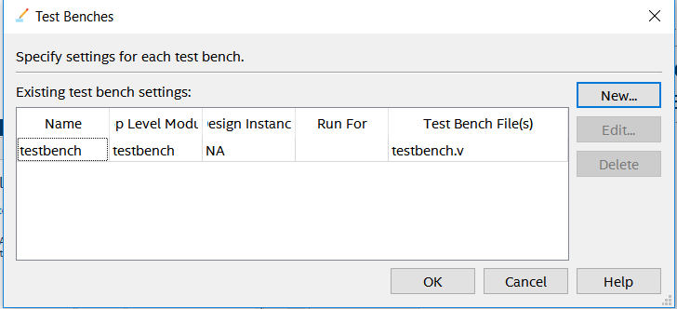
Setting up ModelSim from Intel Quartus
Assignments → Settings→ EDA Tools Settings → Simulation
In NativeLink Settings → Test Benches → NEW
Add New testbench → OK

Slide 9
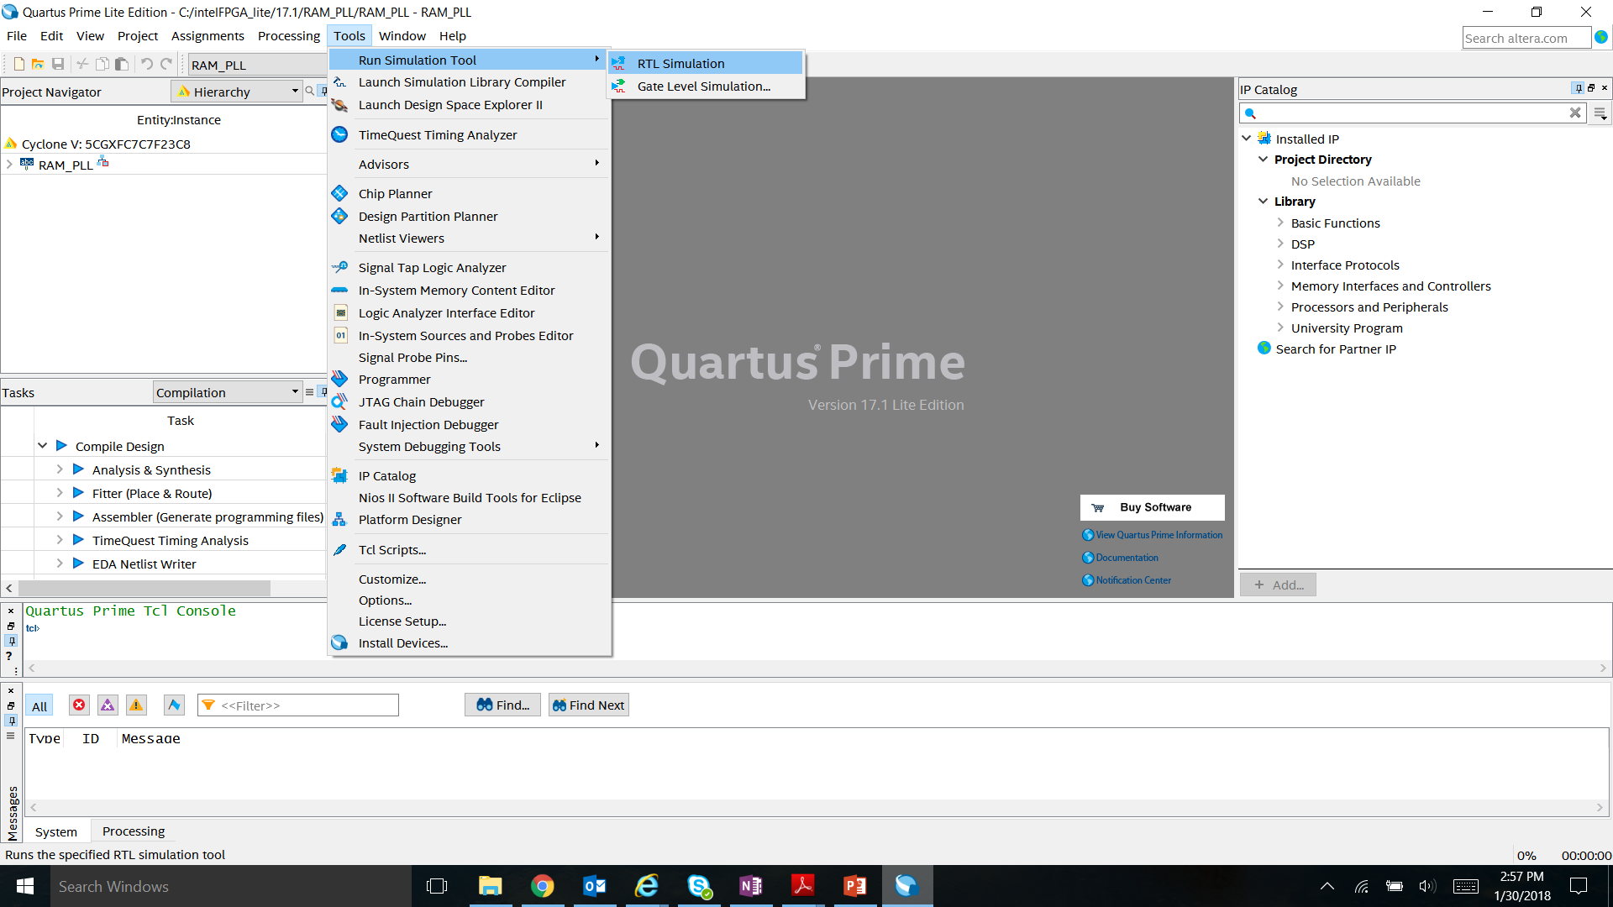
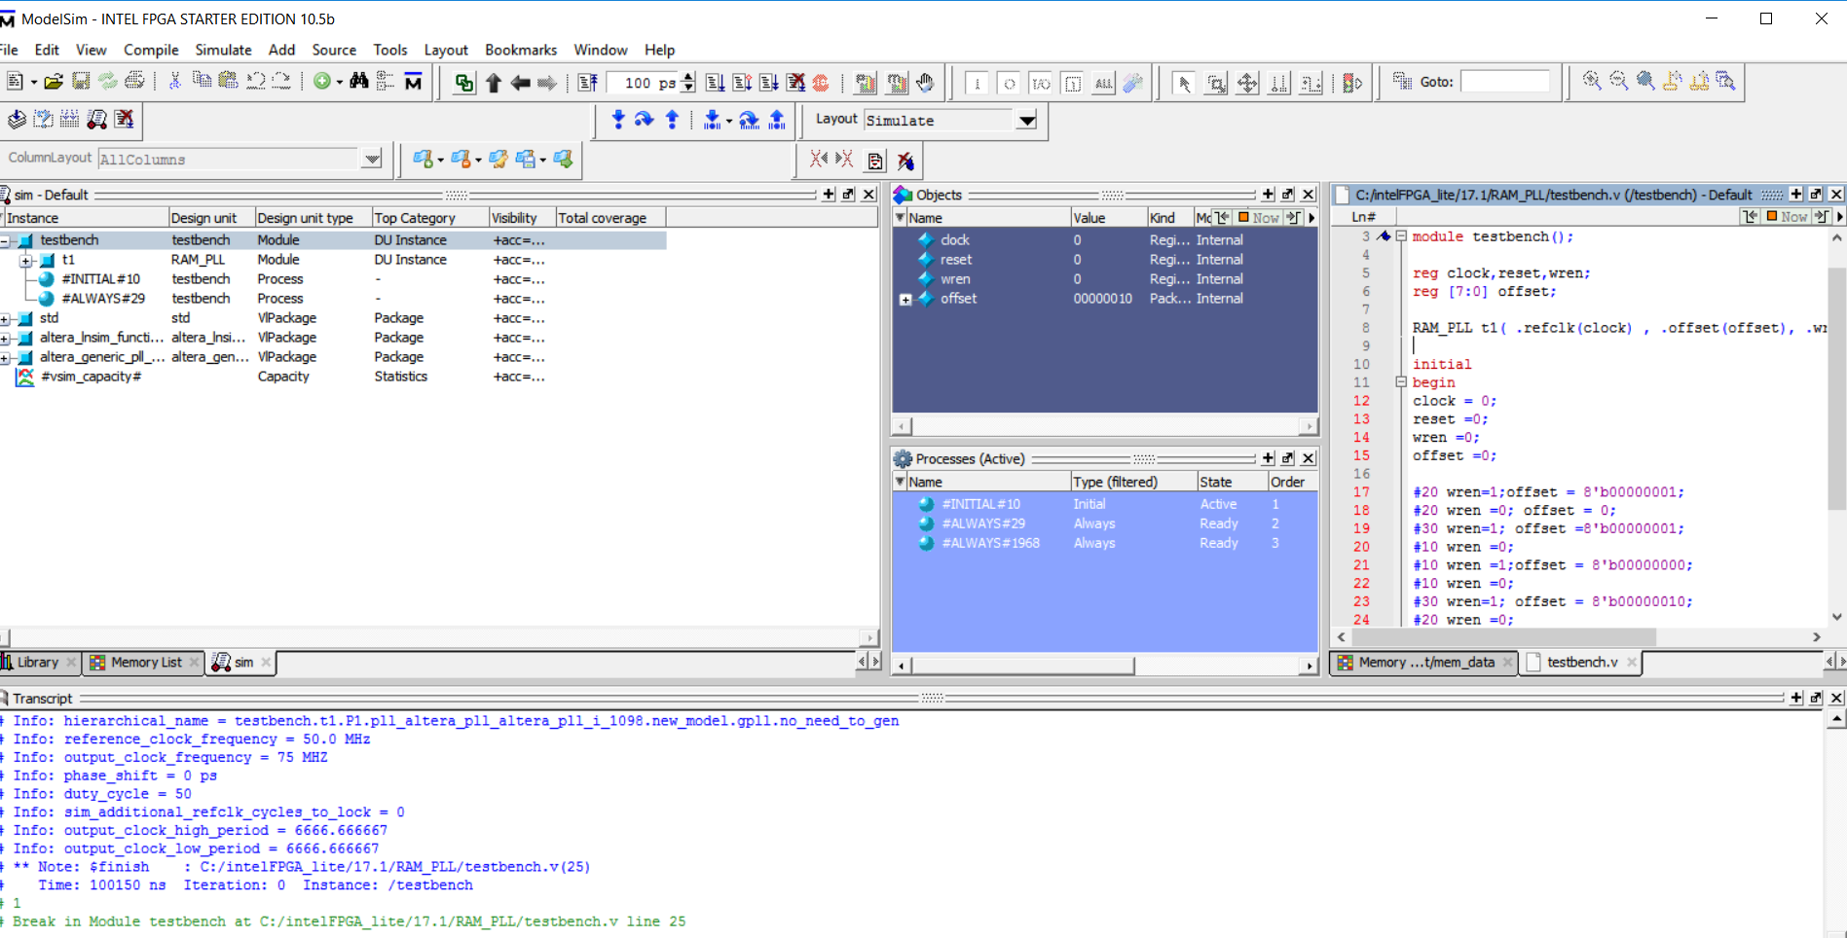
ModelSim GUI
Launching ModelSim from Quartus Tools →Run Simulation Tool → RTL Simulation
Simulation Objects
Testbench File
Command Transcript Window

